Slide 1

2025 International Conference on Smart & Sustainable Technology (INCSST) Hosted By : K. L. E. College of Engineering & Technology , Chikkodi , Karnataka , India
Real-Time Mobile Phone Usage Detection and Automated Ticketing Using YOLO Deep Learning Algorithm
Paper ID: 465
M.VAMSI KRISHNA : 21691A04Q9
P.VENU KUMAR : 21691A04R9
M.VISHNUVARDHAN : 21691A04T0
Affiliation
Department of ECE,
Madanapalle Institute of Technology & Science (MITS),
Madanapalle, Andhra Pradesh, India

Slide 2
Introduction
This project detects mobile phone usage by two-wheeler riders in real-time.
It uses the YOLO deep learning model and a Raspberry Pi for processing.
A USB webcam captures live video of the riders.
YOLO analyzes the video to check if a rider is using a mobile phone.
If a violation is found, the number plate is read using Tesseract OCR.
An LCD screen displays the detected information.
The system helps improve road safety by detecting and reporting violations automatically

Slide 3
Problem Statement & Objectives
Problem Statement: Existing traffic monitoring systems fail to automatically detect and penalize two-wheeler riders using mobile phones.
Project Objectives:
Detect mobile phone usage by two-wheeler riders using YOLOv8.
Identify and extract the vehicle number plate using OCR.
Send an automated email with ticket and evidence to the violator.

Slide 4
Proposed System Overview
Camera
YOLOv8 Detection
OCR
Email Module
LCD Display
Main Modules:
Camera: Captures real-time images of two-wheeler riders.
YOLOv8: Detects mobile usage, rider, number plate, and vehicle.
OCR (Tesseract): Extracts text from number plates.
Email System: Sends violation details to registered email.
LCD Display: Shows system status and alerts.

Slide 5
YOLOv8 Model Explanation
YOLO (You Only Look Once) is a state-of-the-art, real-time object detection algorithm.
YOLOv8 Features:
Fast and accurate detection
Single forward pass: real-time capable
Suitable for edge devices like Raspberry Pi
Custom Classes Trained:
Rider
Mobile phone
Number Plate
Two-wheeler

Slide 6
Dataset & Model Training
Dataset Preparation:
1100+ real-world images collected manually
Labeled using Roboflow
Training Details:
Trained on window powershell using YOLOv8
Image size: 640x640
Epochs: 100
Precision: 91.3%, Recall: 88.5%, mAP: 90%
Visuals:
Confusion matrix
Precision-recall curve
Training loss graphs

Slide 7
Hardware & Software Used
Hardware:
Raspberry Pi 4B
USB Camera (1080p)
LCD Display (16x2 or TFT)
12V Adapter, Power Supply
GPIO for alerts
Software:
Python 3.10
YOLOv8 (Ultralytics)
OpenCV
Tesseract
SMTP for emails
Roboflow for labeling

Slide 8
System Workflow / Algorithm
Capture frame using USB camera.
Run YOLOv8 detection on frame.
Apply OCR on cropped number plate.
Store detection image + text result.
Send automated ticket via email.
Show alert on LCD display.
Mobile
rider
two-wheeler
crop number plate region

Slide 9
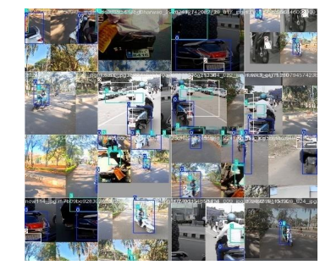
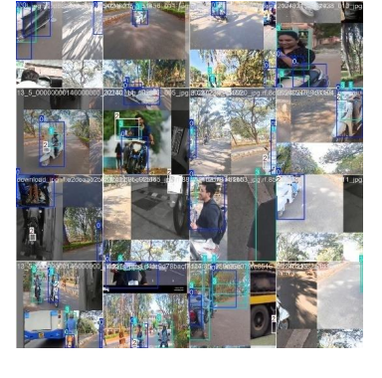
Detection Results
Object Tracking Output Using DeepSORT for Consistent Rider Identification

Slide 10
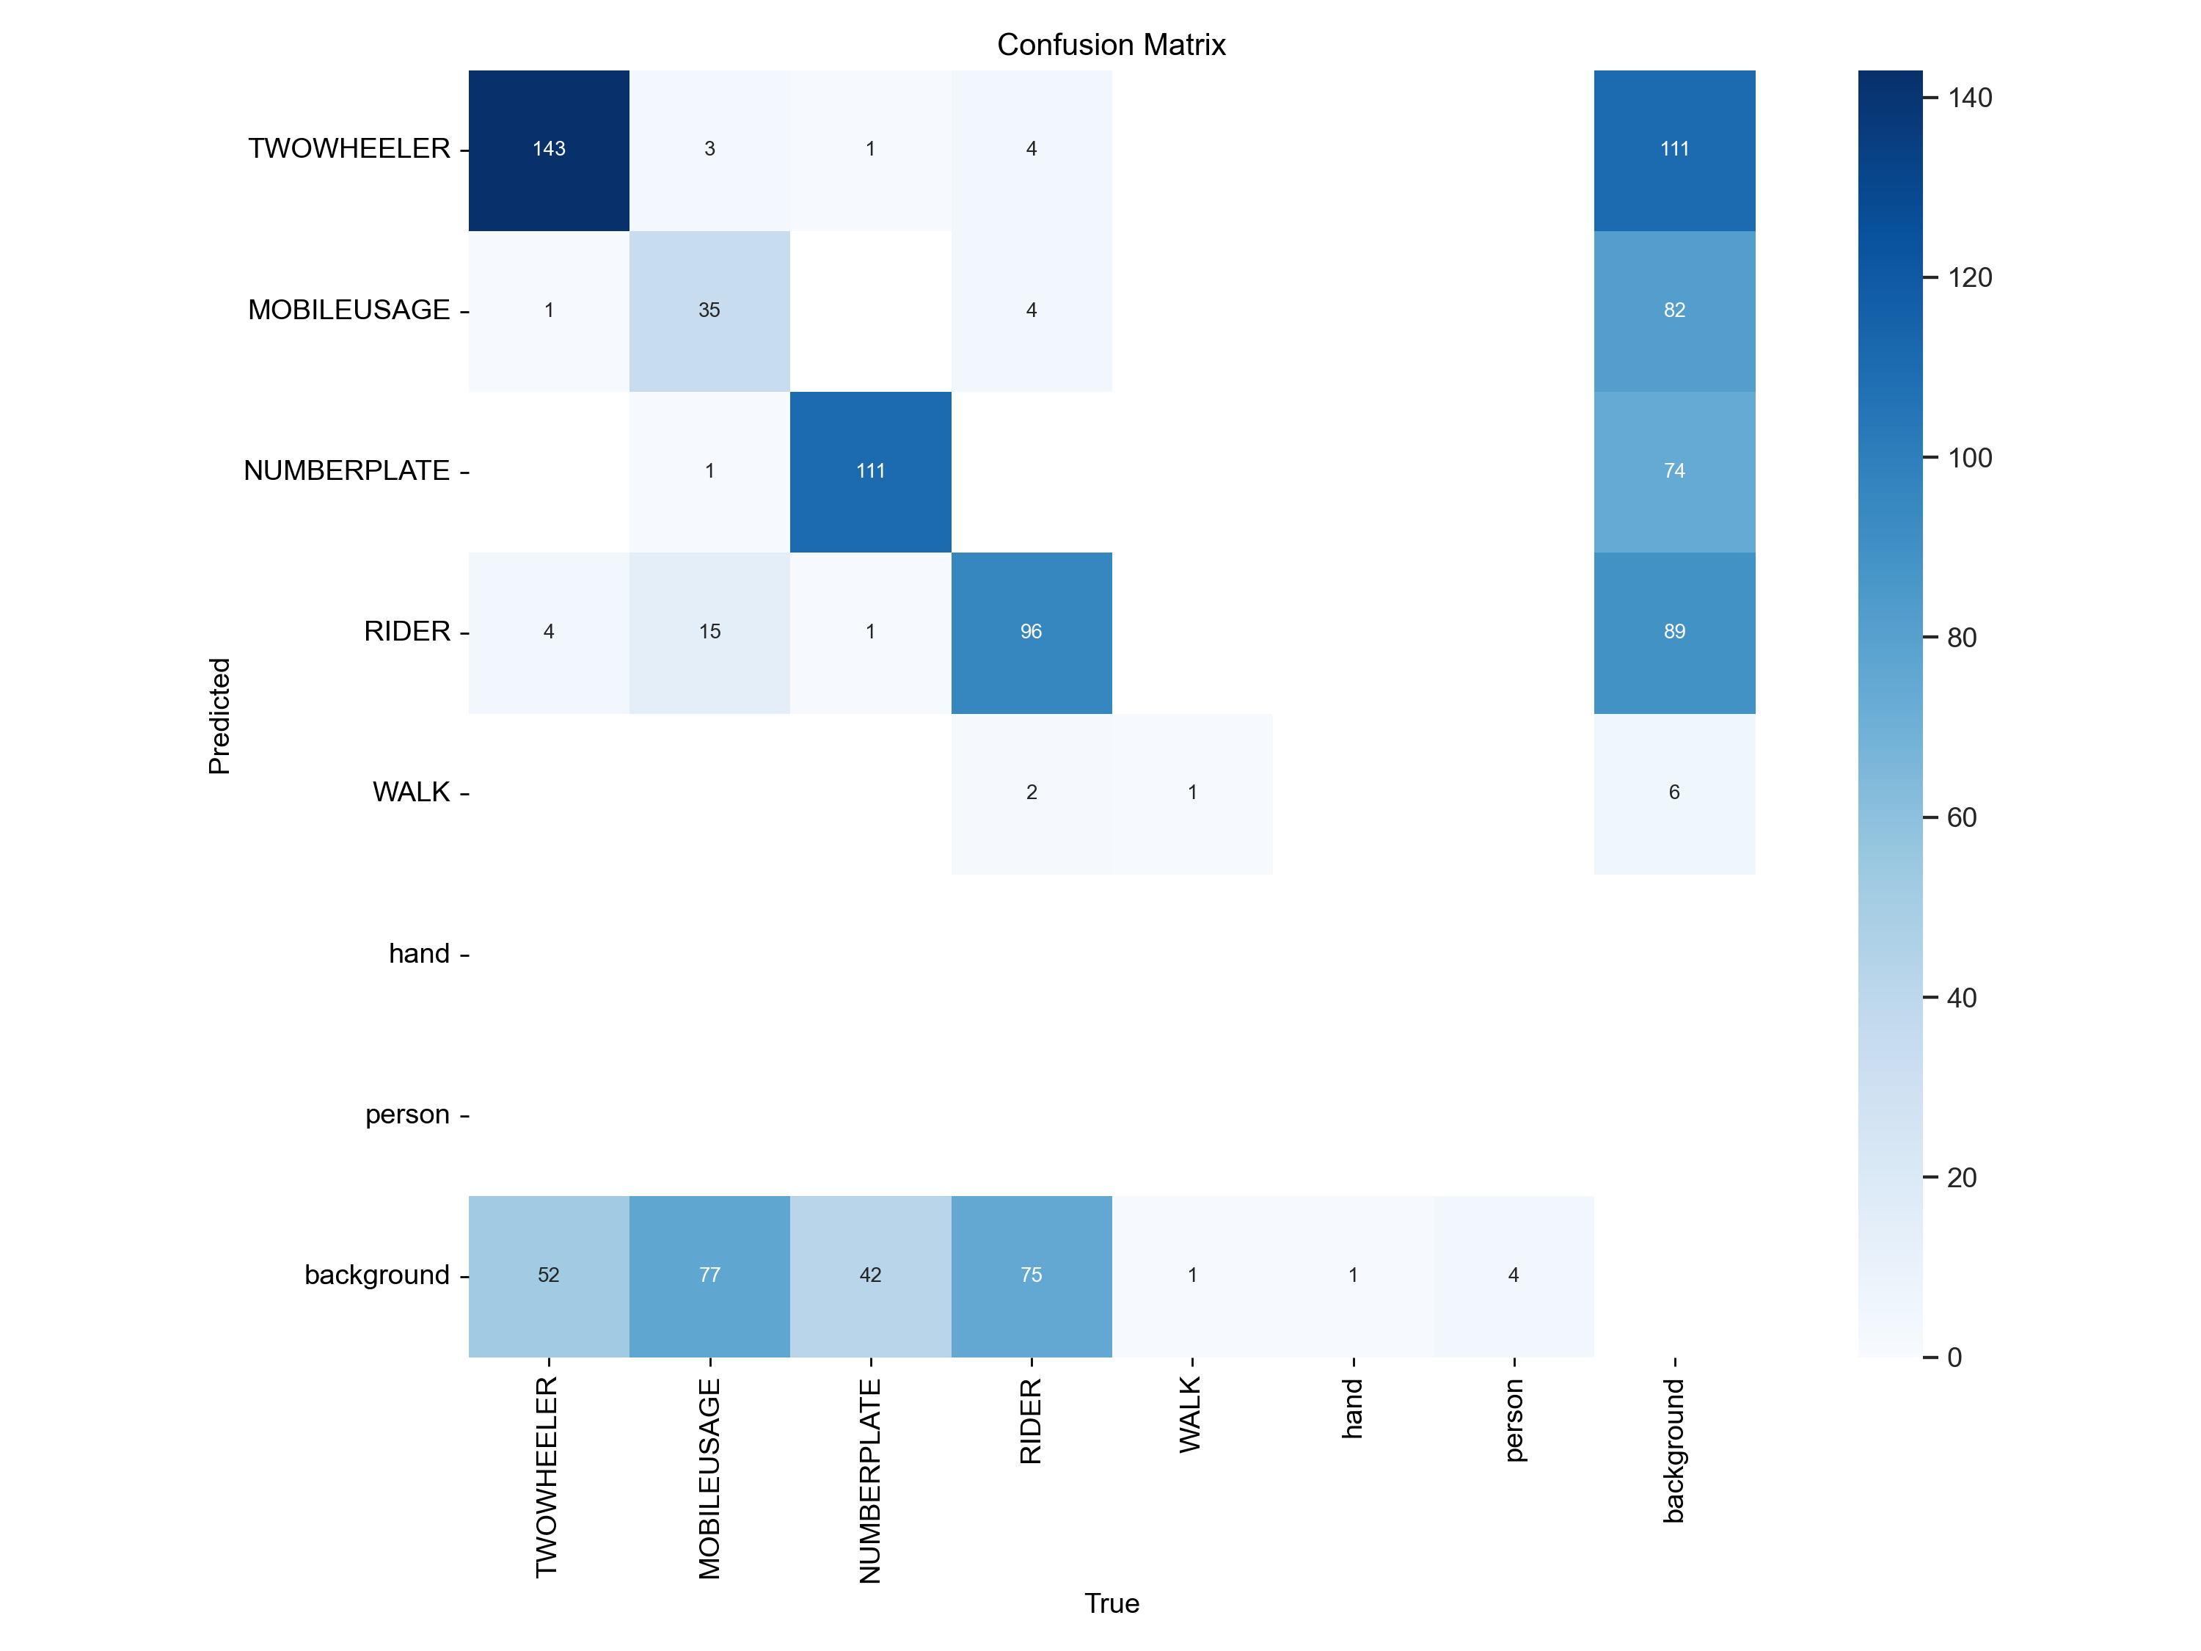
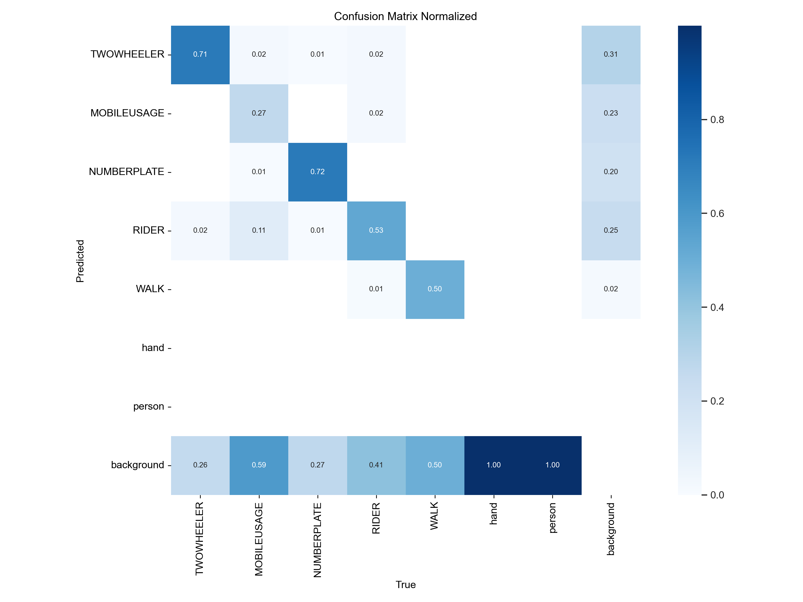
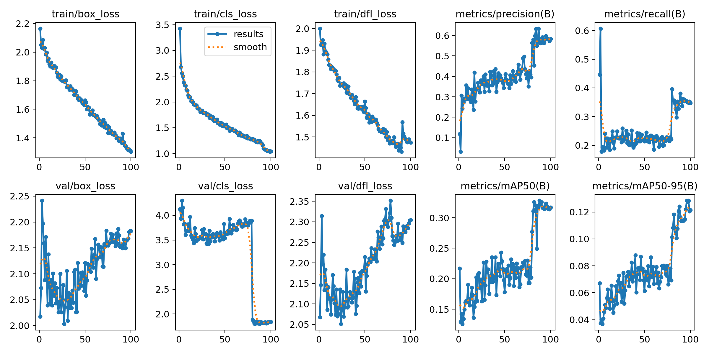

Outputs Graphs
Normalized confusion matrices for multi-class classification of riders, mobile phone users, and license plates.
Training and validation loss and metric trends for the YOLOv8 model over 100 epochs.

Slide 11
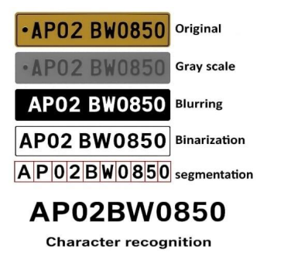
Number Plate Recognition Using Tesseract OCR

Slide 12
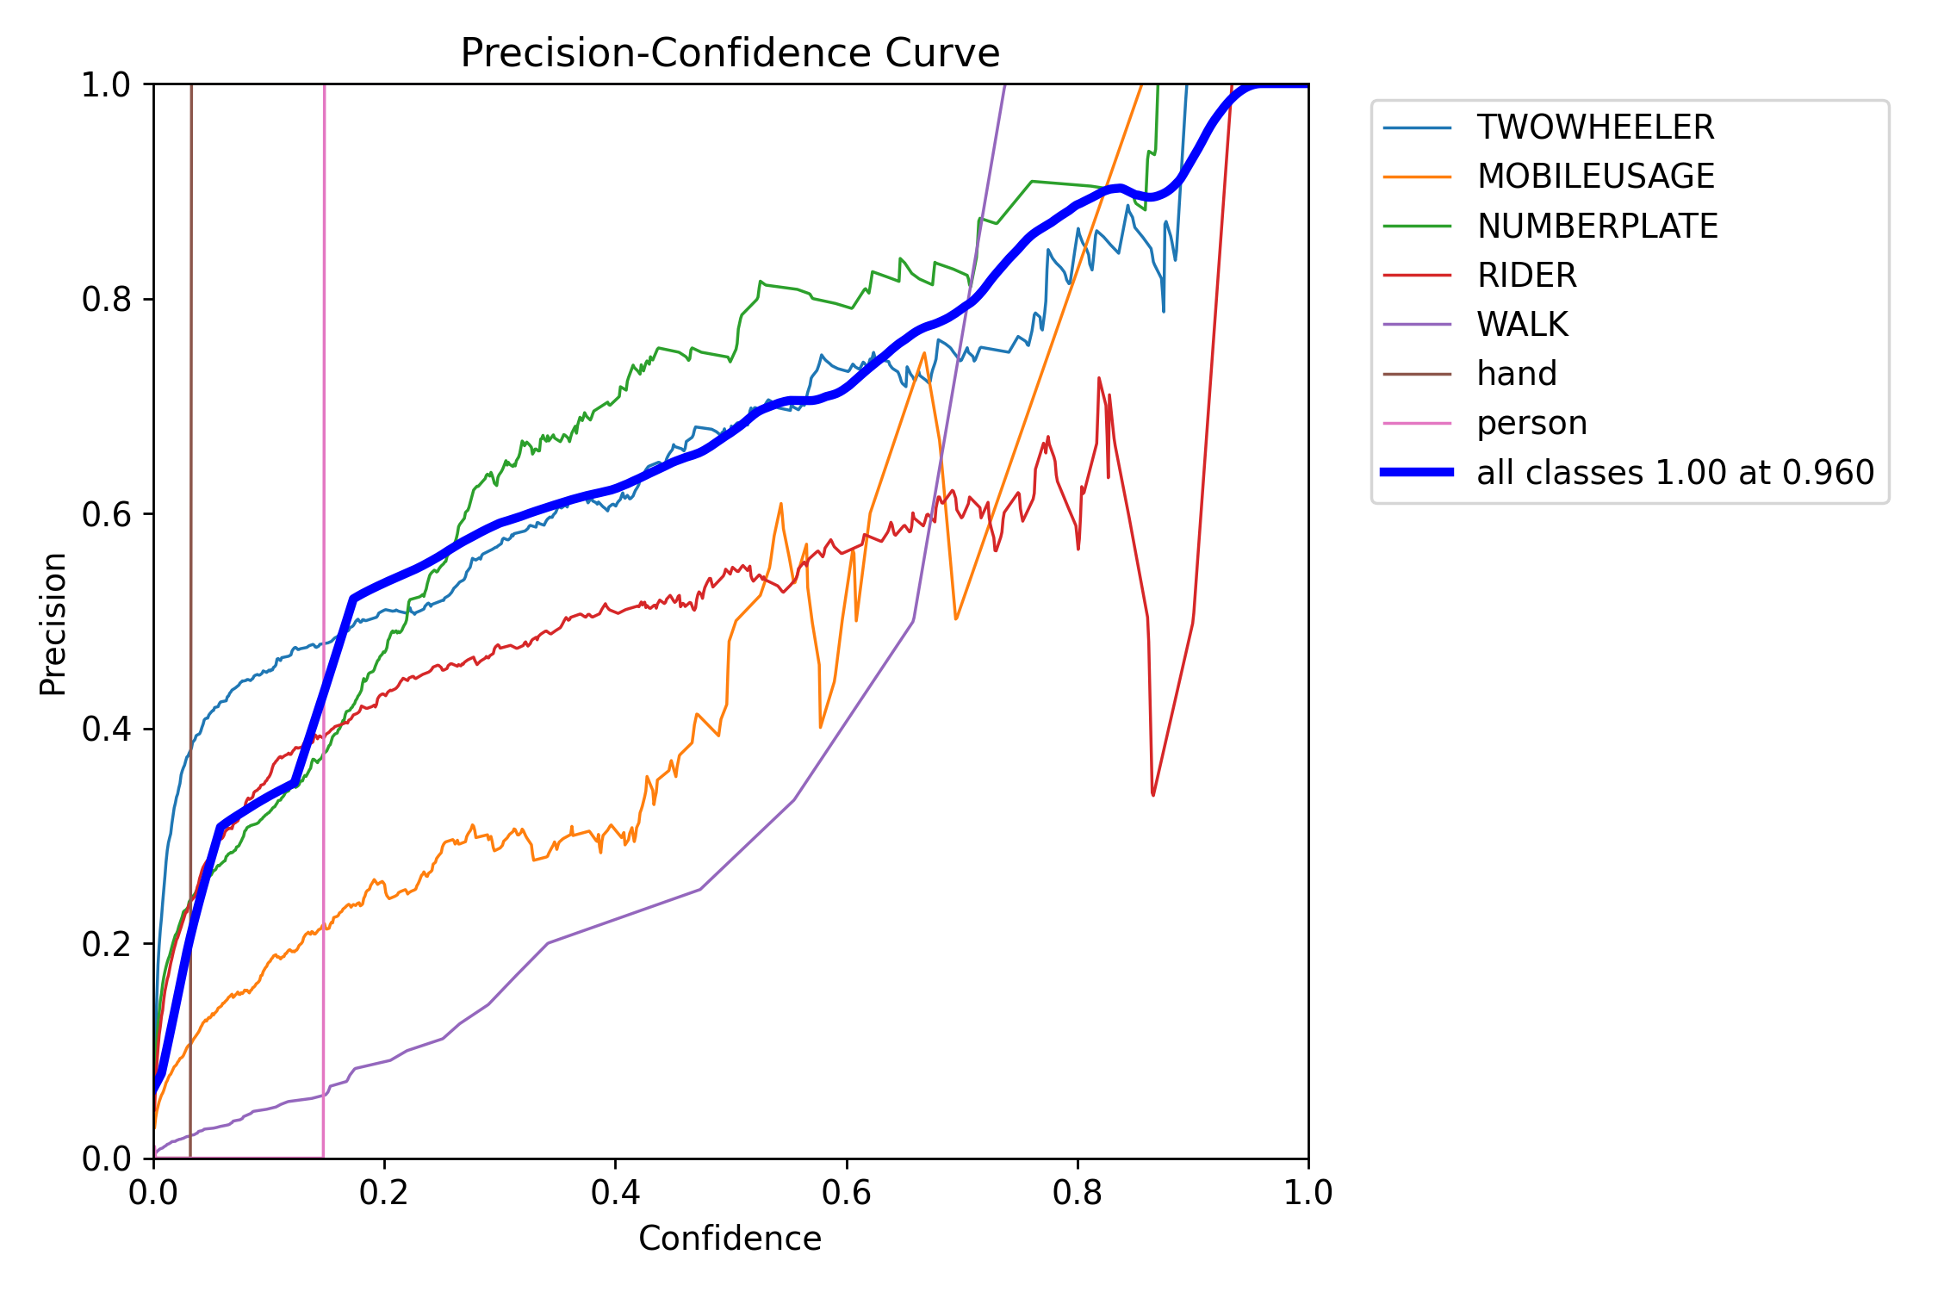
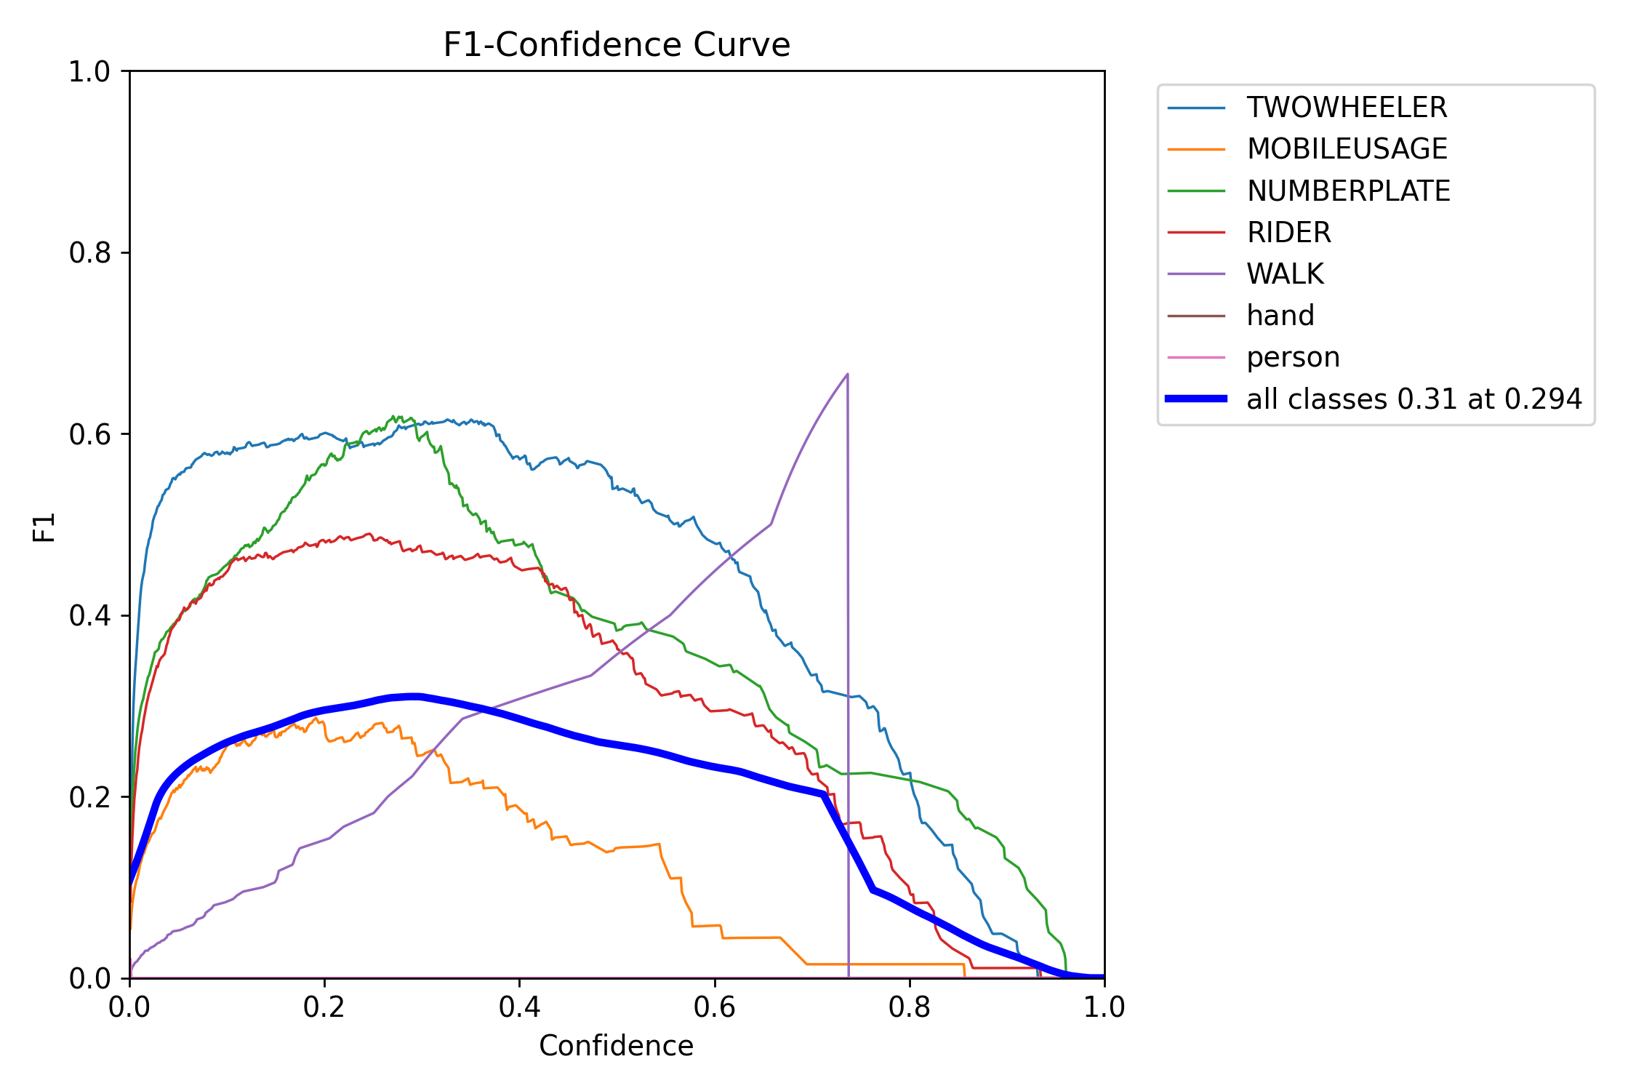
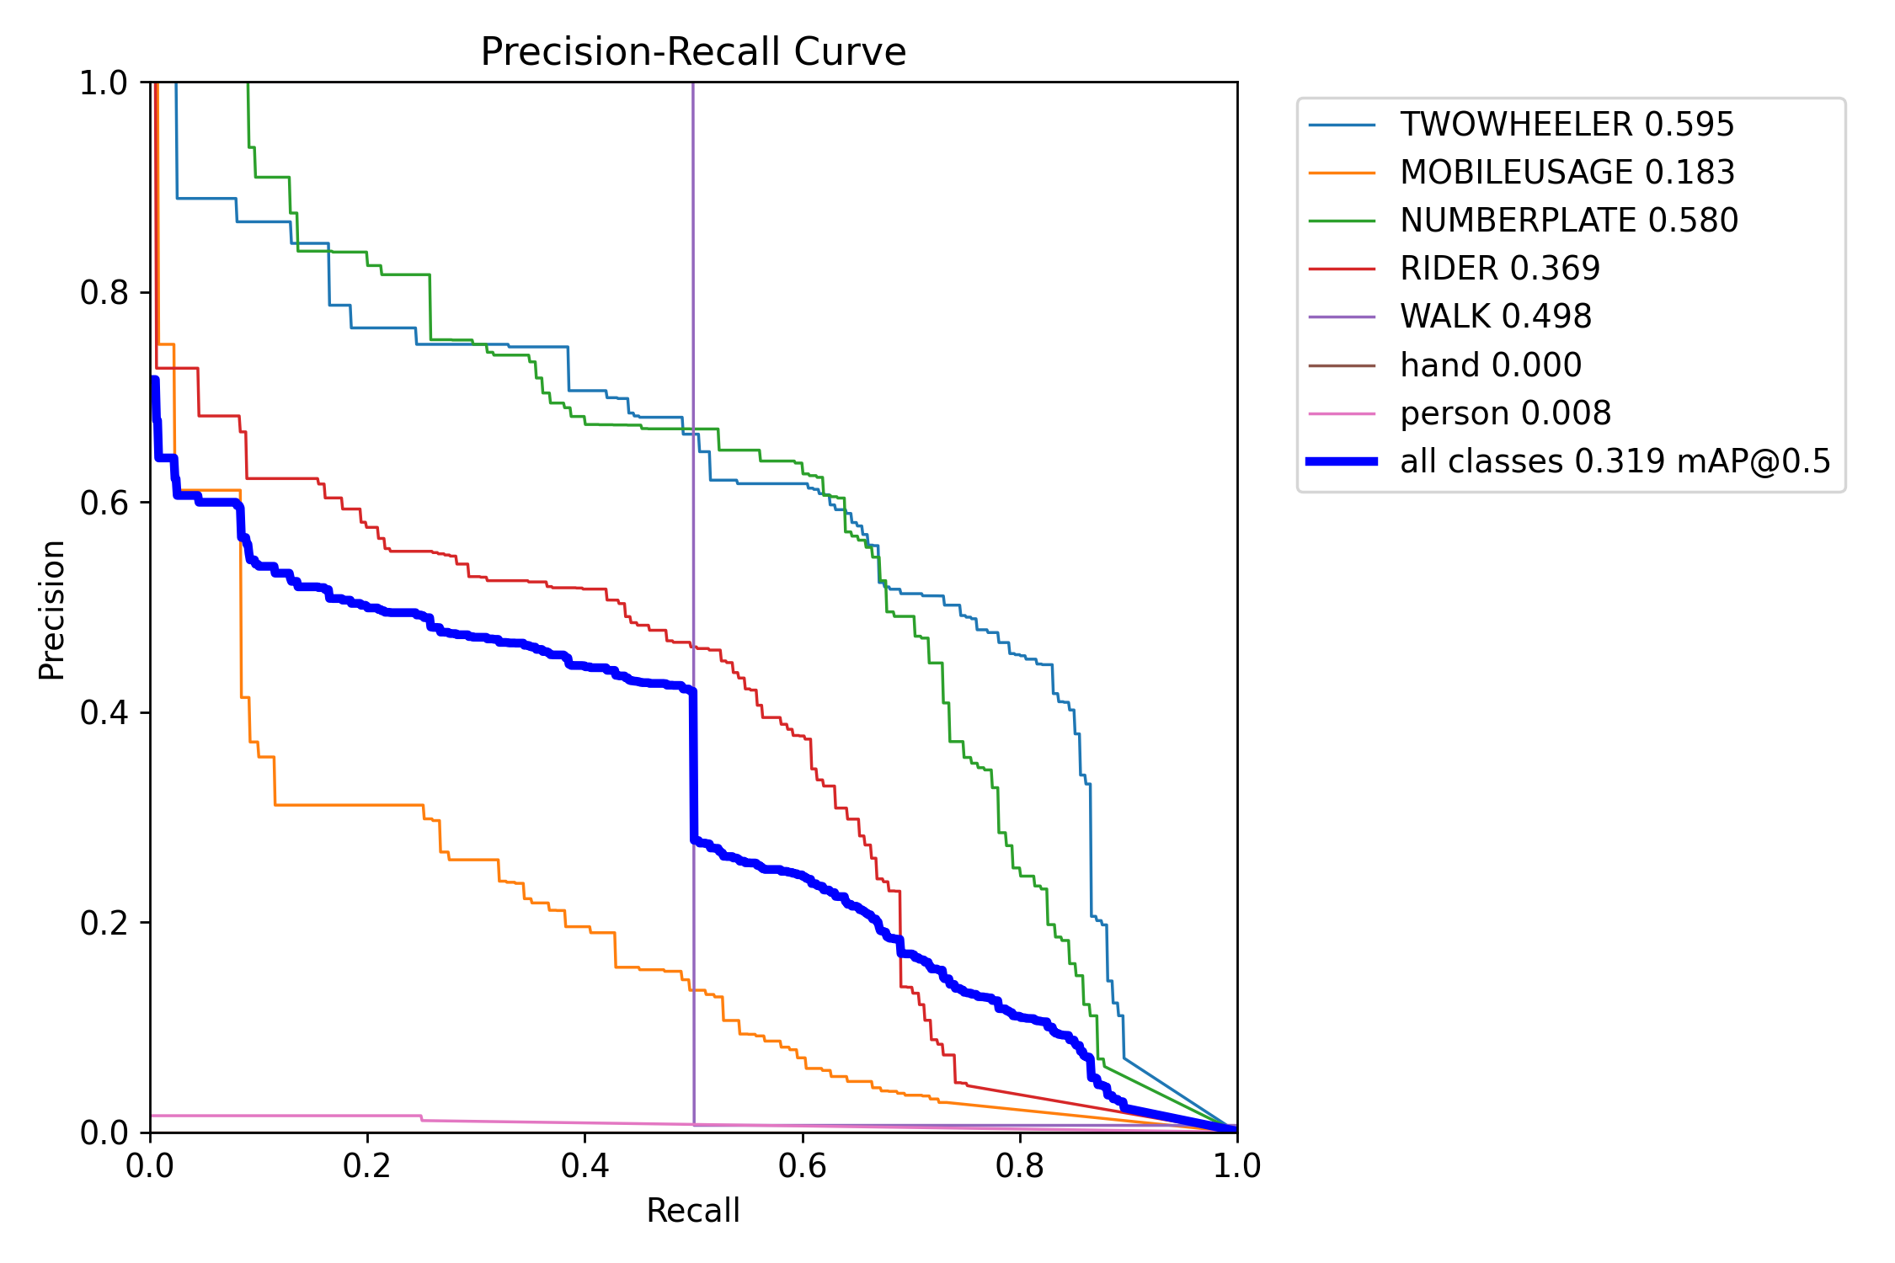
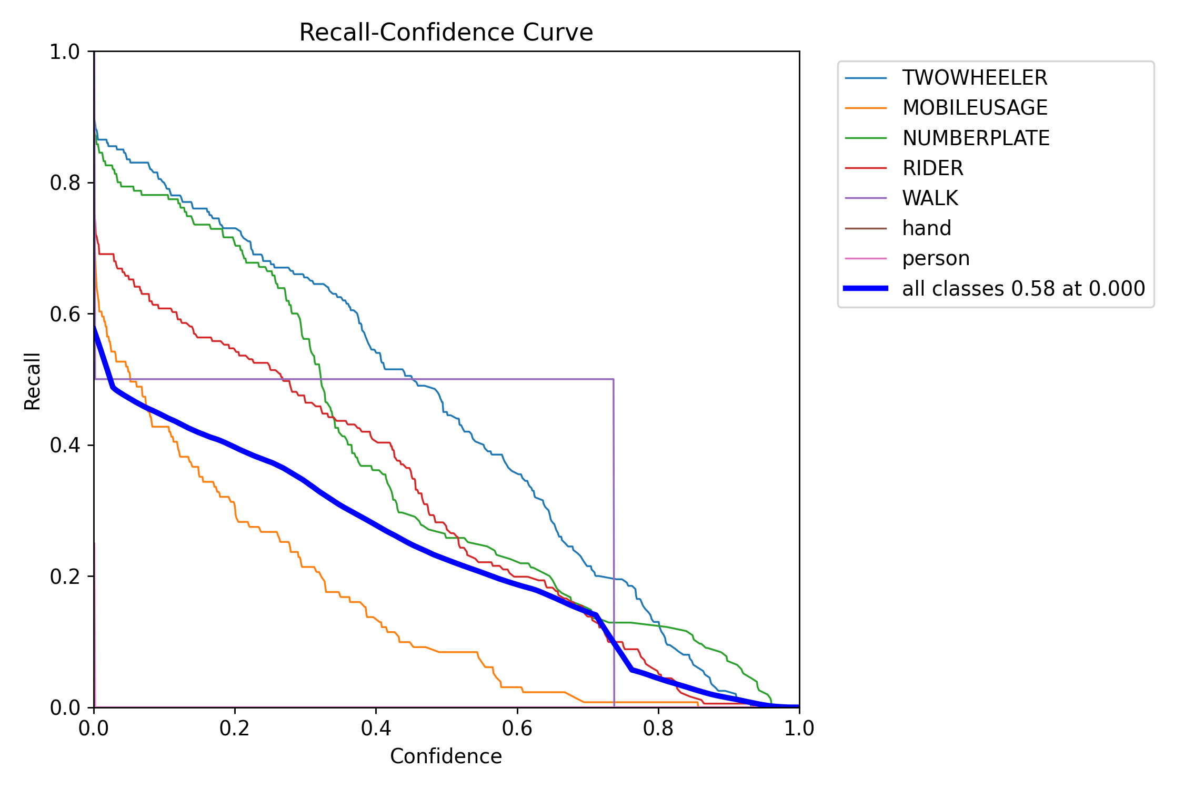

Outputs Graphs
F1 score and precision vs. confidence curves for YOLOv8 multi-class detection performance.
Recall-confidence and precision-recall curves depicting model detection quality.

Slide 13
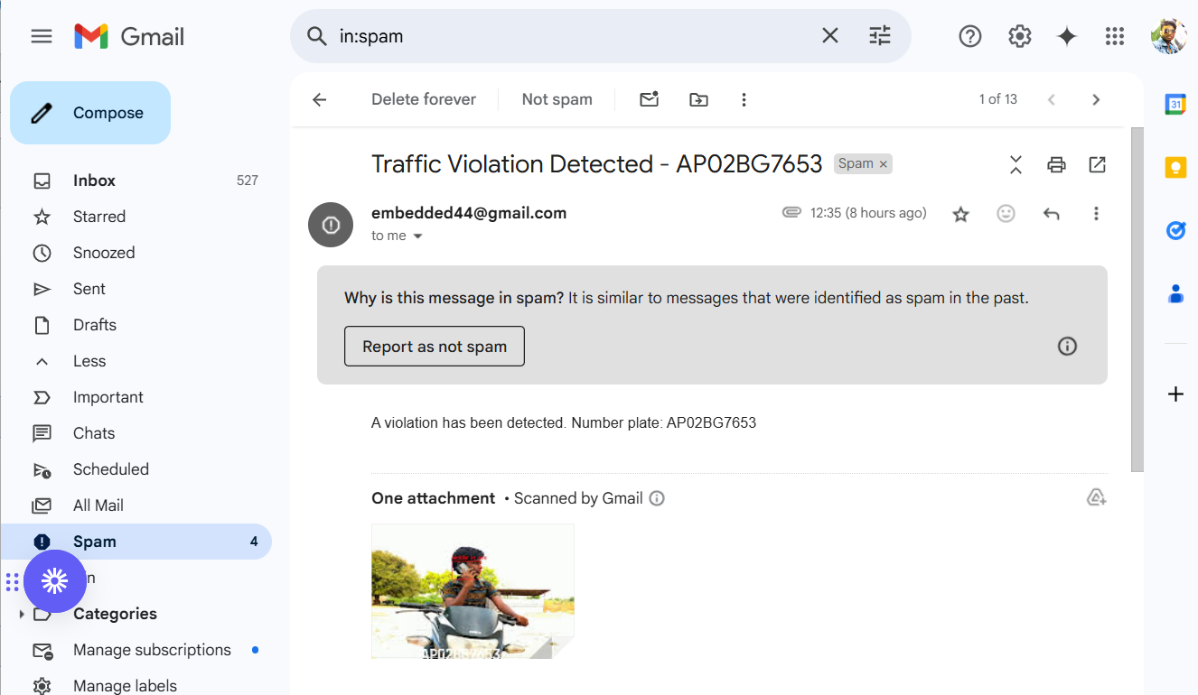
Automated Ticketing Email
Email Components:
Subject: "Traffic Violation Alert"
Body:
Rider detected using mobile phone
Number Plate: AP02BG7653
Date & Time: 12-05-2025 | 12:35 PM
Attachment: Violation image (JPG/PNG)
SMTP Email Code: Python smtplib used to send email securely.
Output Email:

Slide 14
Conclusion&Future Scope
Conclusion:
Successfully implemented real-time detection system.
Automatically captures, identifies, and reports mobile usage by two-wheeler riders.
Effective solution for smart traffic enforcement.
Future Scope:
Integration with RTO database for direct challan issuance.
Helmet detection
Web dashboard for traffic departments
Multilingual OCR support

Slide 15
References
1. Redmon, J., Divvala, S., Girshick, R., & Farhadi, A. (2016). *You Only Look Once: Unified, Real-Time Object Detection*. In Proceedings of the IEEE Conference on Computer Vision and Pattern Recognition (CVPR), 779-788.
2. Zhang, Y., & Xie, L. (2019). *Real-time Object Detection for Mobile Applications Using YOLO*. International Journal of Computer Science and Information Security, 17(4), 23-29.
3. Kumar, A., & Singh, V. (2021). *Mobile Phone Detection for Traffic Safety Using Machine Learning*. Journal of Traffic Safety and Technology, 34(2), 123-132.
Acknowledgements:
Dr. C. Kumar (Guide)
ECE Department, MITS
M.VAMSI KRISHNA : 21691A04Q9
P.VENU KUMAR : 21691A04R9
M.VISHNUVARDHAN : 21691A04T0
Open-source communities (Ultralytics, OpenCV, Roboflow, etc.)

